Slide 1
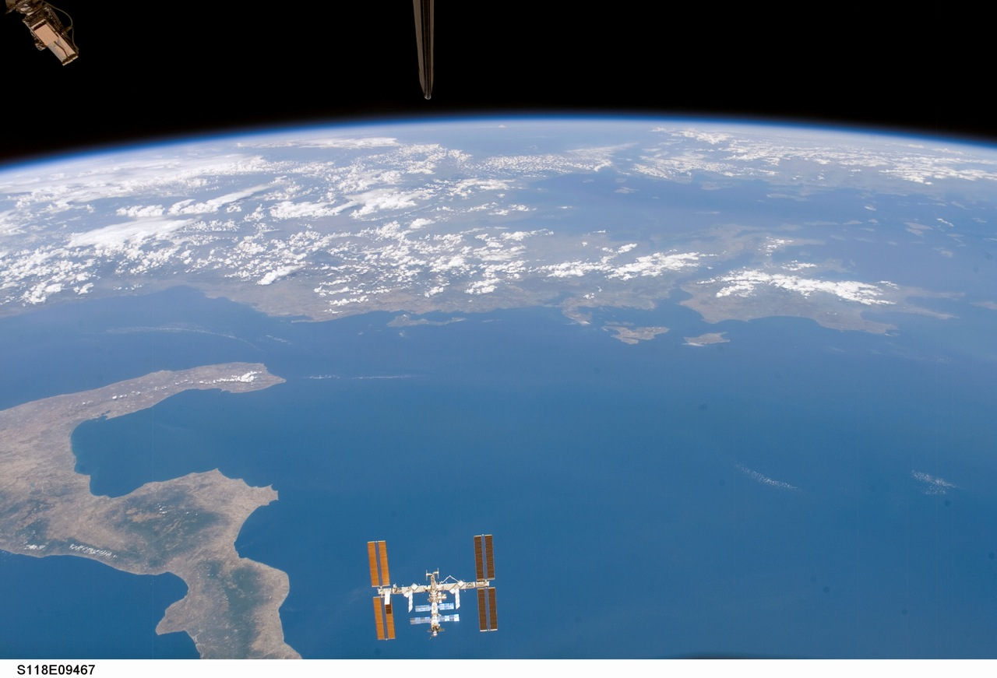

COOL IT!
Group Members:
Dipen Dahal
Dharmaraj Rupakheti
Narayan Prasad Nepal
Susan Baskota

Slide 2
INTRODUCTION
Create a real time micro net of sensors.
sensor kit consists of humidity and temperature sensor.

Slide 3
OBJECTIVE
Understand local environment conditions.
Educate the community about the urban heat island effect, weather, and climate.

Slide 4
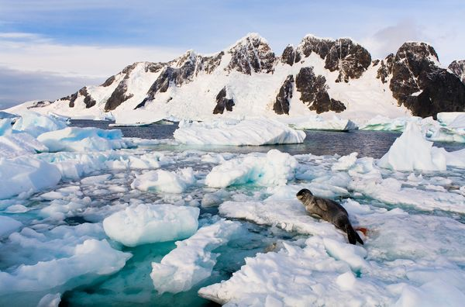
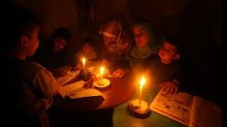
MOTIVATION
<<< Global warming.
>>>Energy crisis

Slide 5
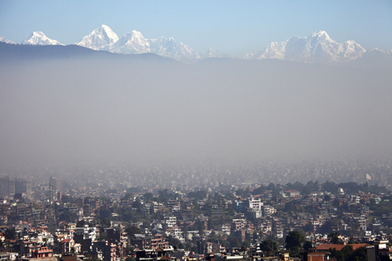
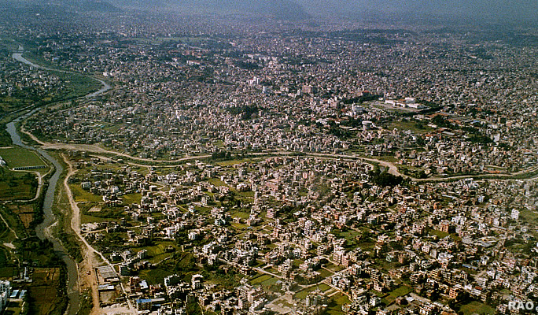
MOTIVATION
<<< Pollution
Over population >>>

Slide 6

SYSTEM OVERVIEW
Sensor kit 1
Sensor kit 2
Sensor kit 3
Android Phone
Web Server
User ‘s Phone
User ‘s Phone

Slide 7
METHODOLGY
Sensors kits sends data via SMS.
Android mobile as central controller.
Controller feeds the processed data to web server.
Users gets the info of data from web server.

Slide 8

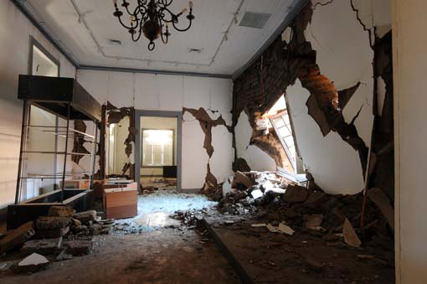
APPLICATION
ddcb
<<< Educate Community
>>> Data source

Slide 9
CONCLUSION
Cheap, reliable, easy to implement.
Educate the community.

Slide 10
THANK YOU

